Slide 1
The Future of Automation: Responsive Systems for diverse conditions

Slide 2
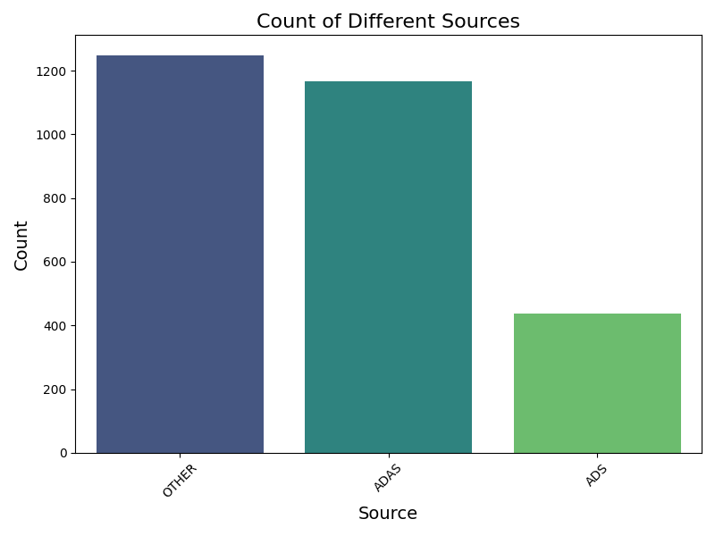
Is it more dangerous than human driving?
Notes:
Cant give conclusion

Slide 3
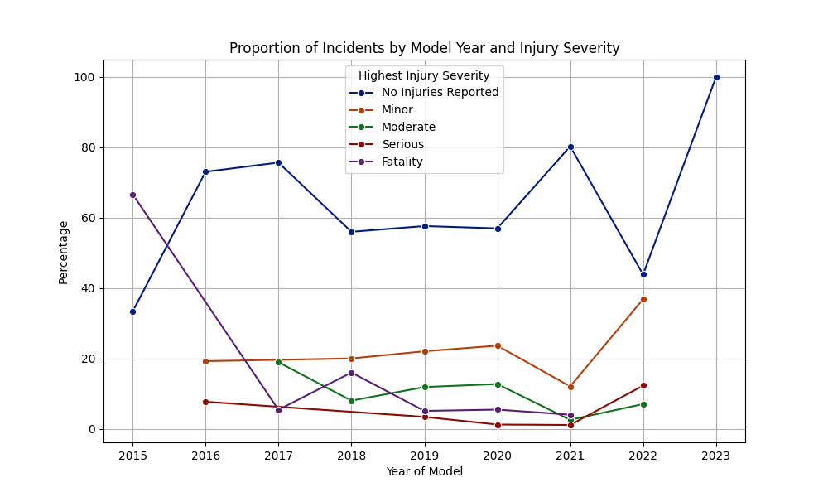
Improvement by year

Slide 4
Safer by years

Slide 5
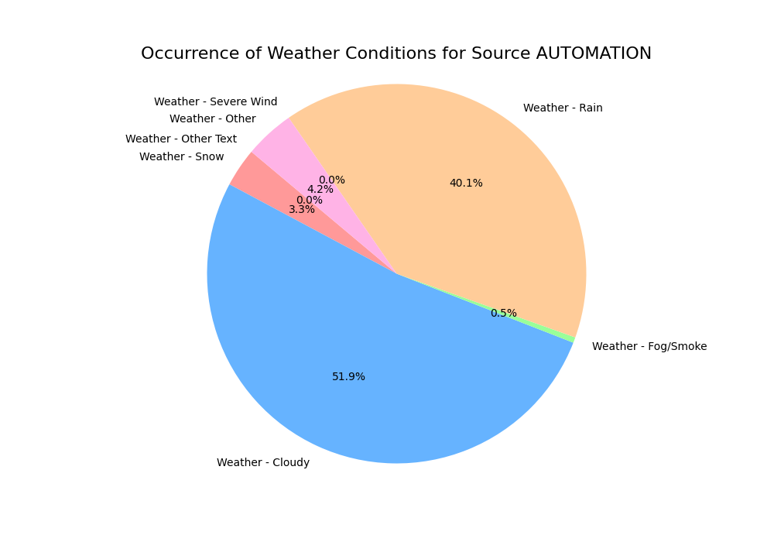
Weather?

Slide 6
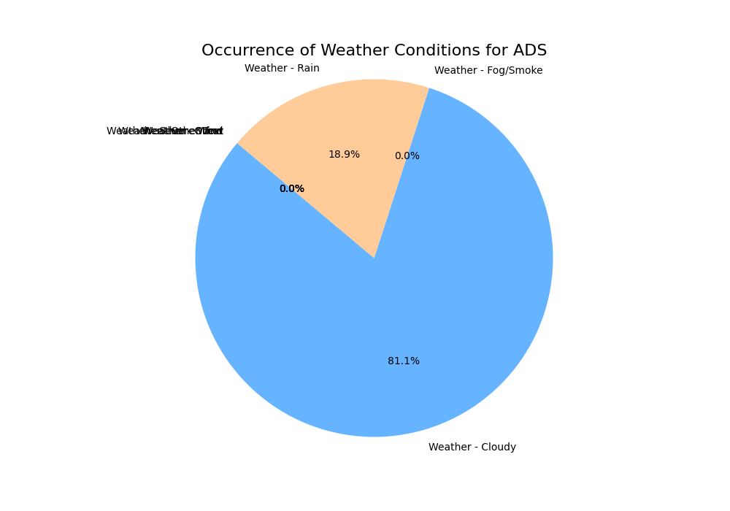
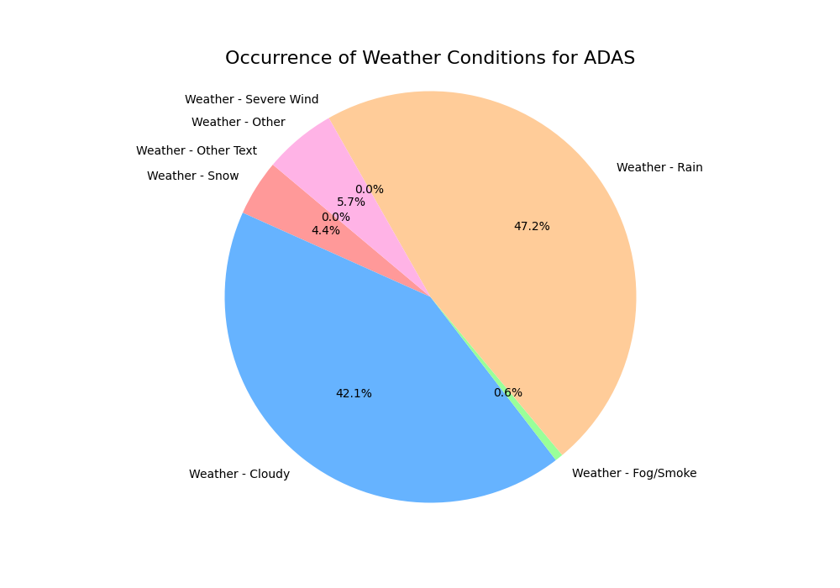
Weather

Slide 7
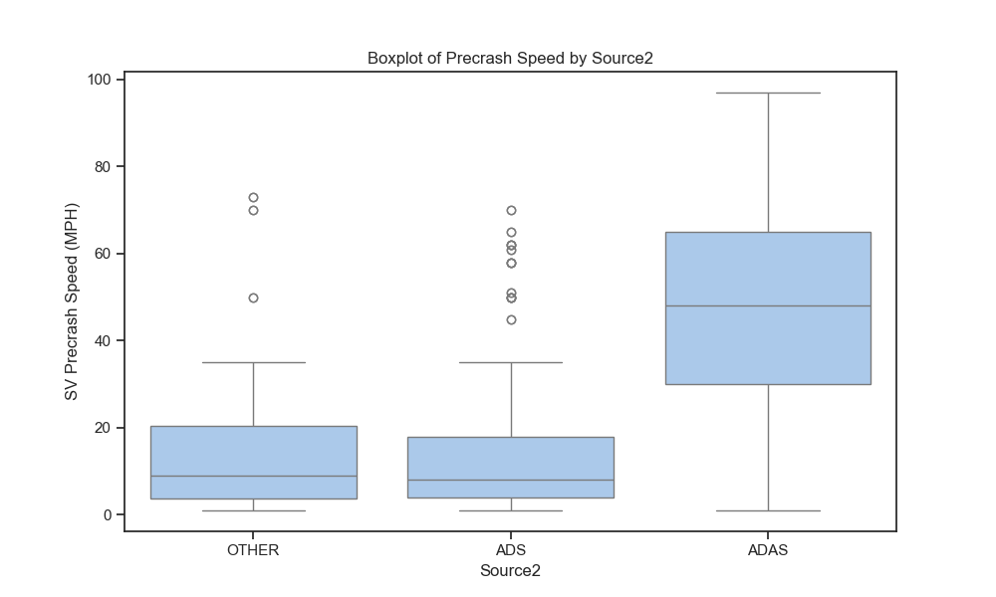
Speed?

Slide 8
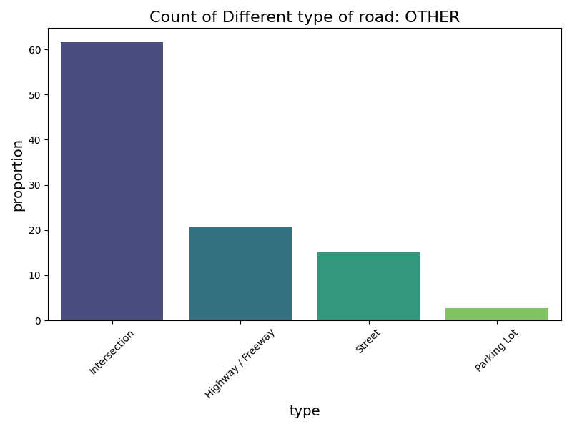
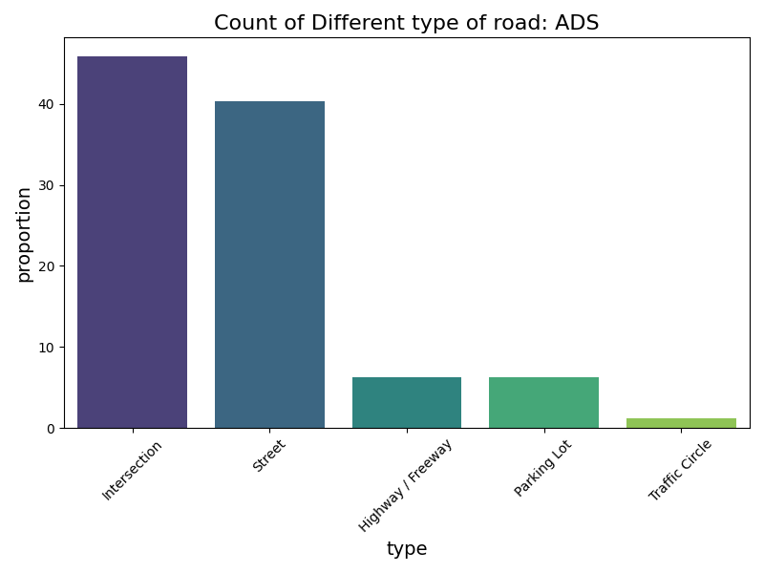
Road type?

Slide 9
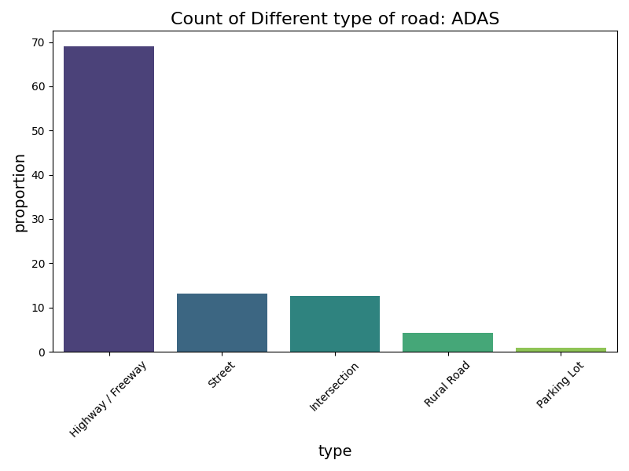
Road type?

Slide 10
Why
Easy to detect
Control
Enough data

Slide 11
ADS
ADAS
Road: Highway
Speed: high
Weather: not cloudy
Road: Intersection
Speed: low
Weather: not cloudy and rain

